Slide 1

Topics to be covered
5.1 Introduction to Polymorphism
5.2 Function overloading
5.3 overloading unary and binary operators and type conversion
5.4 Relationships among Objects in an Inheritance Hierarchy
5.5 Virtual Functions and Virtual Destructors
5.6 Abstract Classes and Pure virtual Functions
5.7 Runtime Polymorphism and Compile-Time Polymorphism
5.8 Operator Overloading Fundamentals
5.9 Dynamic Memory Management with new and delete
5.10 Resource acquisition is initialization (RAII) and Smart Pointers
5.11 Three-Way Comparison Operator(< = >)
5.12 Converting Between Types
5.13 Explicit Constructors and Conversion Operators
5.14 Overloading the Function Call Operator ()

Slide 2
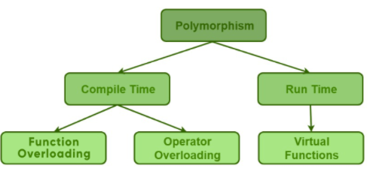
Introduction to Polymorphism

Slide 3
Introduction to Polymorphism
Polymorphism means more than one form. That is, the same entity (function or operator) behaves differently in different scenarios.
Compile time polymorphism / Static Binding / Early Binding
binding is occuring at compile time
Inheritance is not involved
Run time polymorphism / Dynamic Binding / late Binding
at run time we came to know which method is going to invoke
Inheritance is not involved
Prepared By: Prof. Nishat Shaikh & Dr. Aayushi Chaudhari

Slide 4
Introduction to Polymorphism
Function overloading:
Two or more functions having the same name but different parameters [Refer Unit-2]
Operator overloading:
It is a compile-time polymorphism in which the operator is overloaded to provide the special meaning to the user-defined data type
In other words, giving the C++ operators such as +, *, == additional meanings when they are applied with user-defined data types.
Prepared By: Prof. Nishat Shaikh & Dr. Aayushi Chaudhari

Slide 5
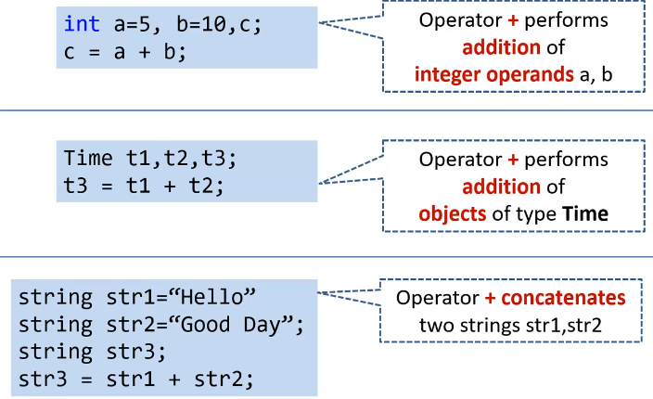
Introduction to Polymorphism

Slide 6
Introduction to Polymorphism
Any symbol can be used as function name
If it is a valid operator in C language
If it is preceded by operator keyword
We can overload all the C++ operators except the following:
Scope resolution operator (::)
Size operator(sizeof)
member selection (.)
member selection with pointer-to-member(.*)
Ternary/conditional operator(?:)
Prepared By: Prof. Nishat Shaikh & Dr. Aayushi Chaudhari

Slide 7
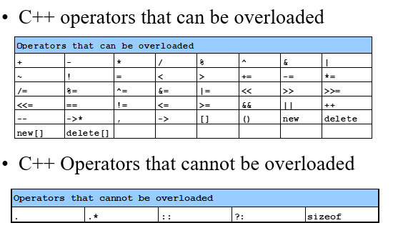
Introduction to Polymorphism
Prepared By: Prof. Nishat Shaikh & Dr. Aayushi Chaudhari

Slide 8
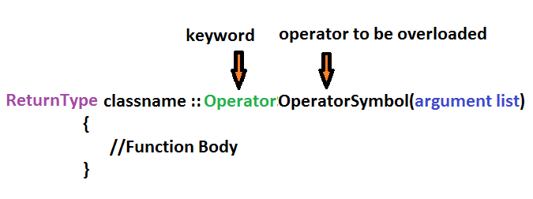
Defining Operator Overloading
The general form of an operator function is:
NOTE:
Operator functions must be either member functions(non-static) or friend functions.
Friend function will have only one argument for unary operators and two for binary operators.
Member function has no argument for unary operators and only one for binary operators.

Slide 9
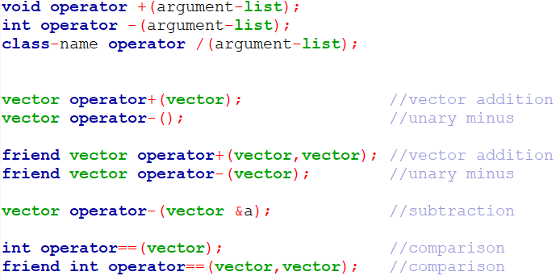
Defining Operator Overloading
Example

Slide 10
Defining Operator Overloading
The process of overloading involves the following steps:
Creates a class that defines the data type that is to be used in the overloading operation.
Declare the operator function operator op() in the public part of the class.
It may be either a member function or a friend function.
Define the operator function to implement the required operations.
NOTE:
When an operator is overloaded , its original meaning is not lost. Eg: the operator +, which has been overloaded to add two vectors, can still be used to add two integers.

Slide 11
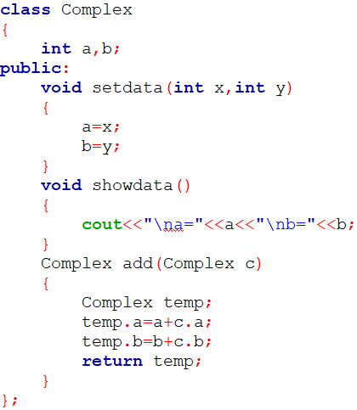
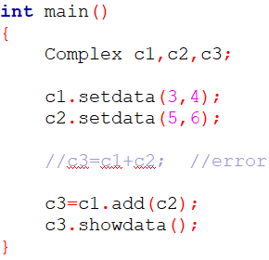

Revision
Unit 7: Operator Overloading
Prepared By: Nishat Shaikh

Slide 12
Overloading Binary Operators
Binary operators work on two operands.
When we overload the binary operator for user-defined types,
The operator function is called using the obj1 object and obj2 is passed as an argument to the function
Unit 7: Operator Overloading
Prepared By: Nishat Shaikh

Slide 13
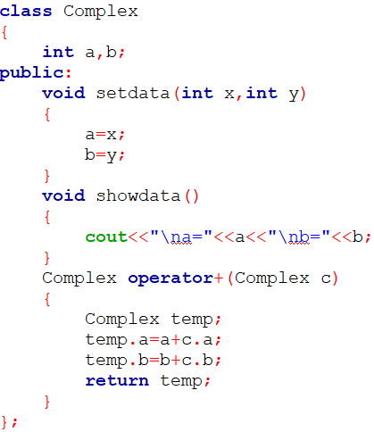
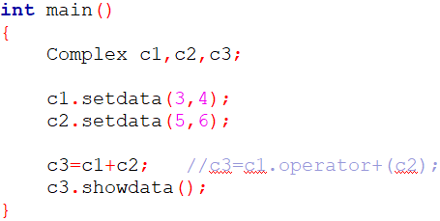

Overloading Binary Operators: Ex-1(Addition)
Unit 7: Operator Overloading
Prepared By: Nishat Shaikh

Slide 14
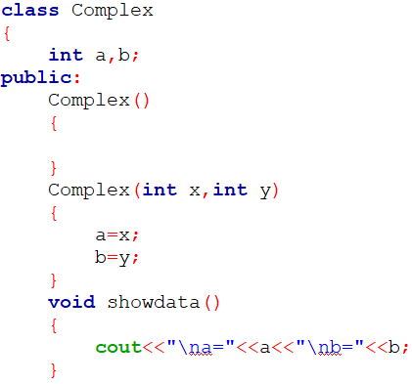
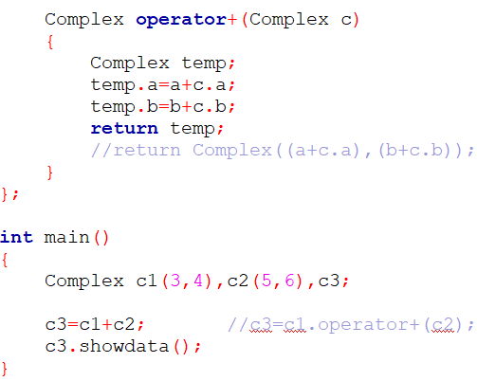
Overloading Binary Operators: Ex-2(Addition)
Unit 7: Operator Overloading
Prepared By: Nishat Shaikh

Slide 15
Overloading Binary Operators
NOTE:
In Overloading Binary Operators, the left-hand operand is used to invoke the operator function and the right-hand operand is passed as an argument.
We can avoid the creation of the temp object by replacing the entire function body by:
When the compiler comes across a class name with argument list, it invokes an appropriate constructor, initializes an object with no name and returns the contents for copying into an object.
Such an object is called a temporary object and goes out of scope as soon as the contents are assigned to another object
Unit 7: Operator Overloading
Prepared By: Nishat Shaikh

Slide 16
Overloading Binary Operators
Define a class NUM having two integer members a and b. A class has member functions for input and output. Overload the operators – and = = such that it supports the following statements:
NUM N1, N2, N3;
N3=N1-N2;
if(N1==N2){...}
Use the concept of Overloading Binary Operators.
Unit 7: Operator Overloading
Prepared By: Nishat Shaikh

Slide 17
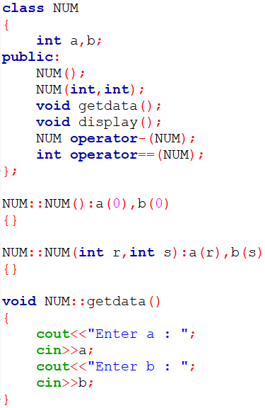
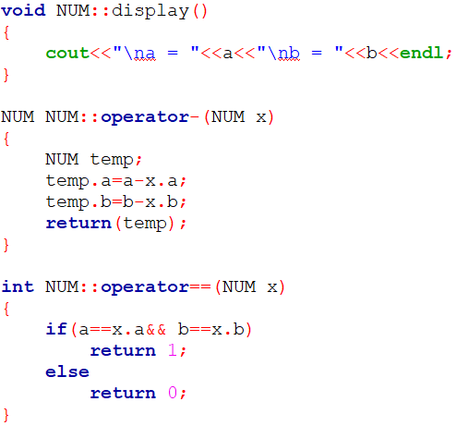
Overloading Binary Operators
Unit 7: Operator Overloading
Prepared By: Nishat Shaikh

Slide 18
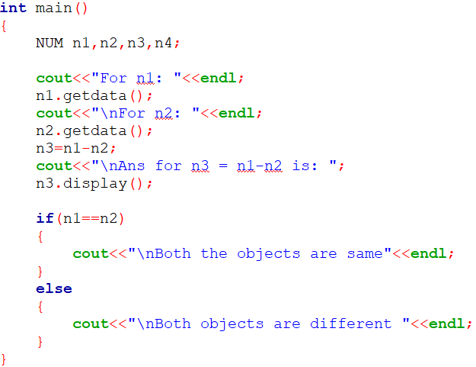
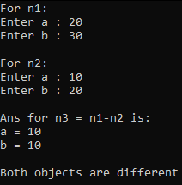
Overloading Binary Operators
Unit 7: Operator Overloading
Prepared By: Nishat Shaikh

Slide 19
Practical :Overloading Binary Operators
Create a class String having character array. Class includes constructor and required member functions to get and display the object. Overload the following operators for the class.
+(s3=s1+s2)
==(s1<s2)
+=(s1+=s2)
Use the concept of Overloading Binary Operators
Unit 7: Operator Overloading
Prepared By: Nishat Shaikh

Slide 20
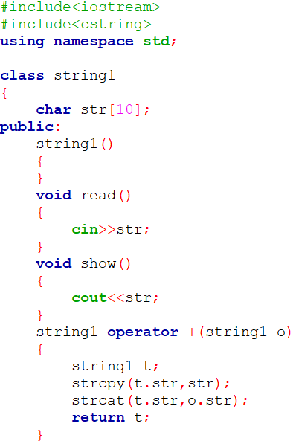
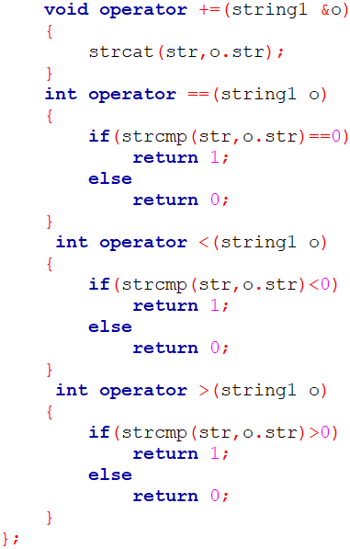
Practical :Overloading Binary Operators
Unit 7: Operator Overloading
Prepared By: Nishat Shaikh

Slide 21
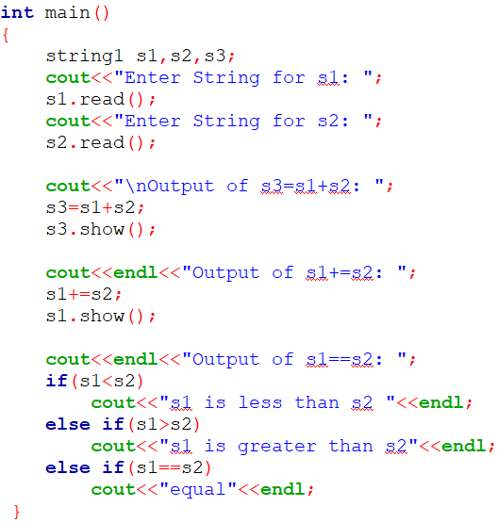
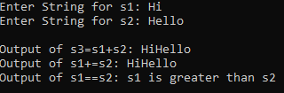
Practical :Overloading Binary Operators
Unit 7: Operator Overloading
Prepared By: Nishat Shaikh

Slide 22

Overloading Binary Operators Using Friend
As stated earlier, friend functions may be used in the place of member functions for overloading a binary operator.
The only difference is friend function requires two arguments to be explicitly passed to it, while a member function requires only one.
There are certain situations where we would like to use a friend function rather than a member function.
Unit 7: Operator Overloading
Prepared By: Nishat Shaikh

Slide 23
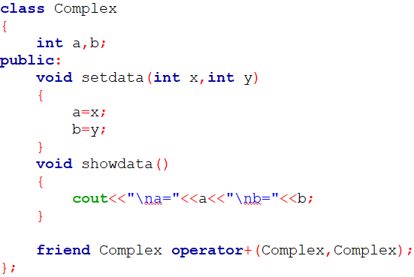
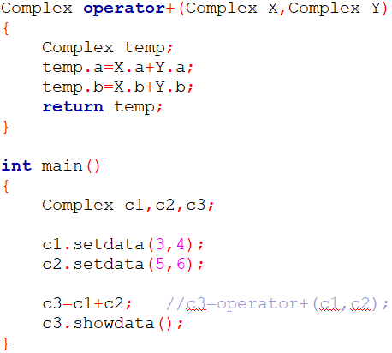
Overloading Binary Operators Using Friend
Unit 7: Operator Overloading
Prepared By: Nishat Shaikh

Slide 24
Practical : Overloading Binary Operators Using Friend
Create a class Measure having members: meter and cm. The class has get( ) and put( ) functions. Overload operator + and – such that they support M1=M2+15 and M3=M1 – 4.5. Also overload + and – such that they support M1=5.0+M2 and M3=2.0 – M4. Write a main( ) to test the class.
Use the concept of Overloading Binary Operators with friend function.
Unit 7: Operator Overloading
Prepared By: Nishat Shaikh

Slide 25
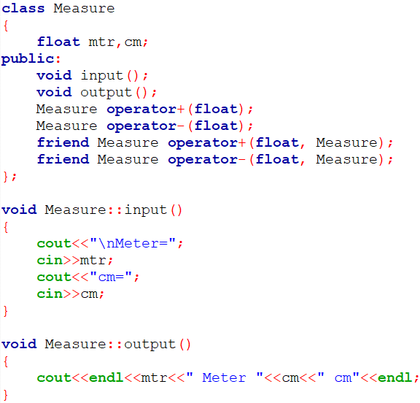
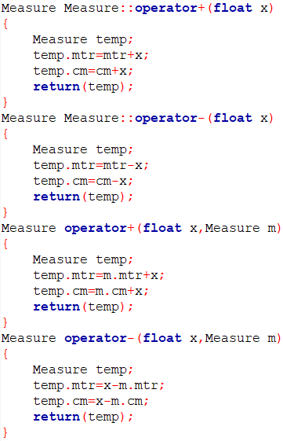
Practical : Overloading Binary Operators Using Friend
Unit 7: Operator Overloading
Prepared By: Nishat Shaikh

Slide 26
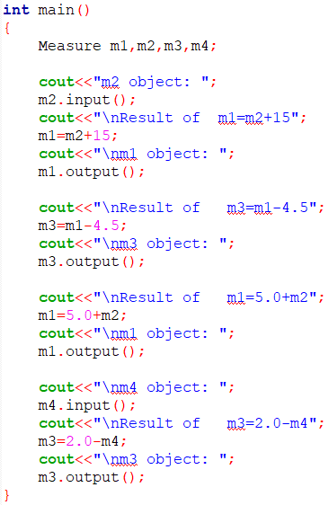
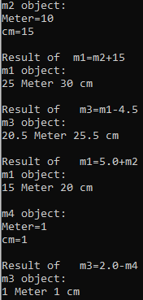
Practical : Overloading Binary Operators Using Friend
Unit 7: Operator Overloading
Prepared By: Nishat Shaikh

Slide 27
Overloading Unary Operators
Unary operators operate on only one operand.
Examples of unary operators
The Unary Minus(-)
increment operator(++)
decrement operator(--)
logical NOT(!)
Unit 7: Operator Overloading
Prepared By: Nishat Shaikh

Slide 28
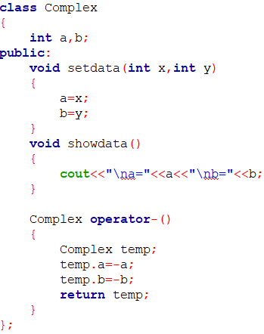
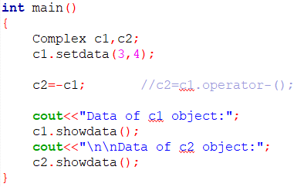
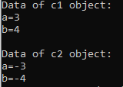
Overloading Unary Operators:Ex-1(Unary Minus)
Unit 7: Operator Overloading
Prepared By: Nishat Shaikh

Slide 29
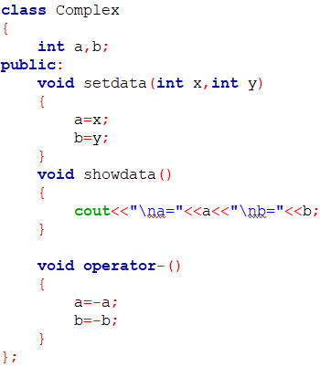
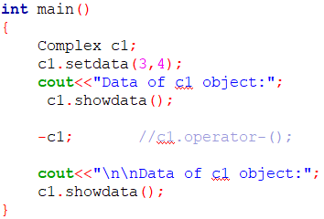
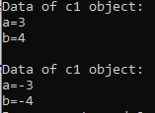
Overloading Unary Operators:Ex-2(Unary Minus)
Unit 7: Operator Overloading
Prepared By: Nishat Shaikh

Slide 30
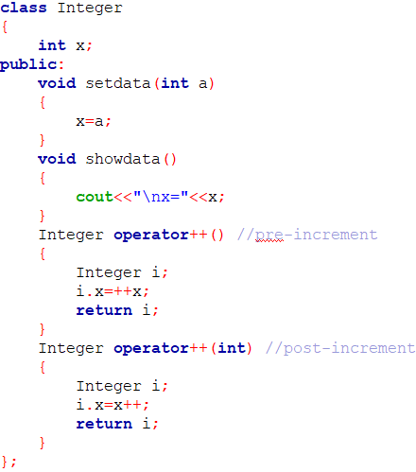
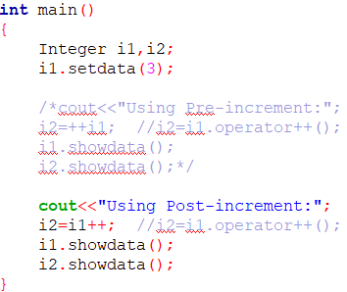


Overloading Unary Operators:Ex-3(Increment)
Unit 7: Operator Overloading
Prepared By: Nishat Shaikh

Slide 31
Practical :Overloading Unary Operators
Create a class Number having int num as member. The class has input and output functions. Overload unary operator (++) such that it supports N1=N2++ and N3=++N1 and Overload unary (-) such that it supports N3 = - N3. Also define default, parameterized and copy constructor for the class. Also explain use of nameless object in operator overloading.
Use the concept of Overloading Unary Operators.
Unit 7: Operator Overloading
Prepared By: Nishat Shaikh

Slide 32
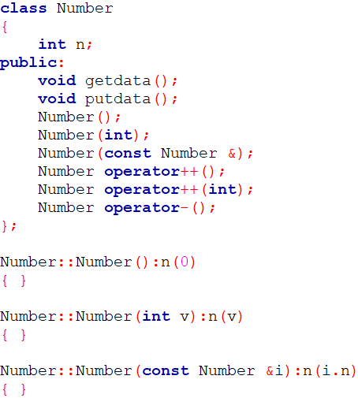
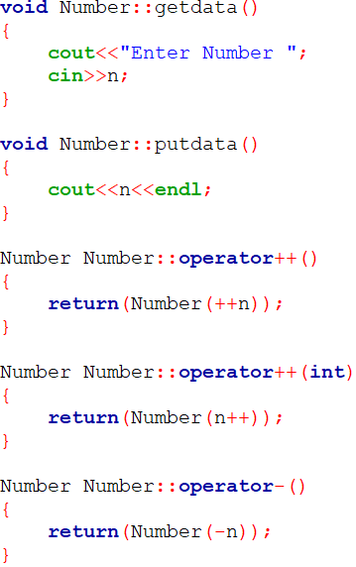
Practical :Overloading Unary Operators
Unit 7: Operator Overloading
Prepared By: Nishat Shaikh

Slide 33
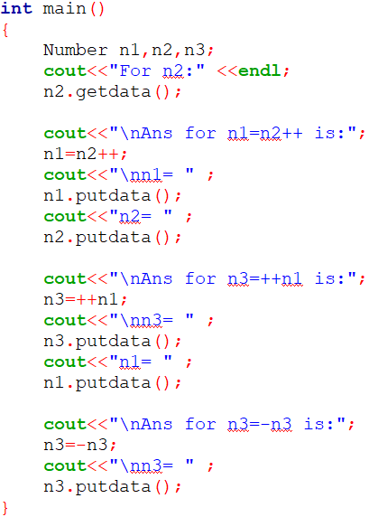
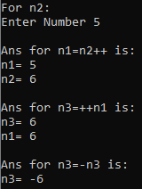
Practical :Overloading Unary Operators
Unit 7: Operator Overloading
Prepared By: Nishat Shaikh

Slide 34
Overloading Unary Operators Using Friend
As stated earlier, friend functions may be used in the place of member functions for overloading a Unary operator.
The only difference is friend function requires one arguments to be explicitly passed to it, while a member function requires none.
Unit 7: Operator Overloading
Prepared By: Nishat Shaikh

Slide 35
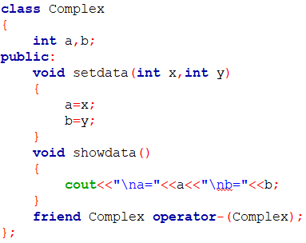
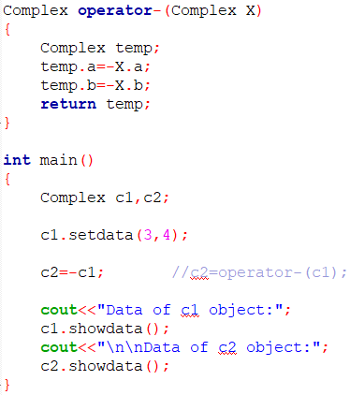
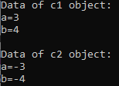
Overloading Unary Operators Using Friend:Ex-1
Unit 7: Operator Overloading
Prepared By: Nishat Shaikh

Slide 36
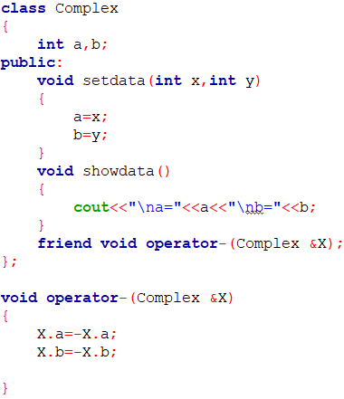
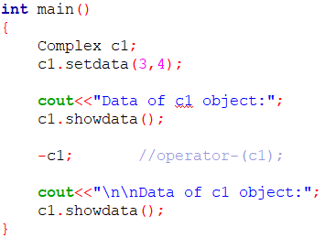
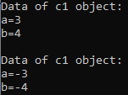
Overloading Unary Operators Using Friend:Ex-2
NOTE: If we pass argument by value, it will not work
Unit 7: Operator Overloading
Prepared By: Nishat Shaikh

Slide 37
Practical : Overloading Unary Operators Using Friend
Create a class complex having data members int real , img and member function to print data. Overload Unary operator (-) using friend function such that it supports – C1 where C1 is the object of class complex. Also define default, parameterized and copy constructor for the class.
Use the concept of Overloading Unary Operators with friend function.
Unit 7: Operator Overloading
Prepared By: Nishat Shaikh

Slide 38
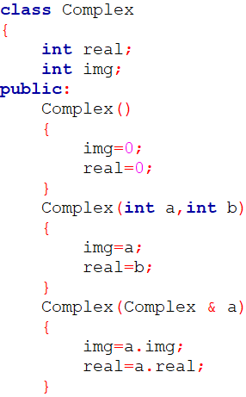
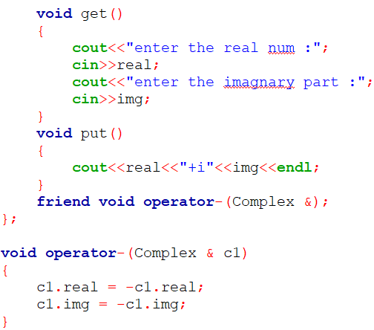
Practical : Overloading Unary Operators Using Friend
Unit 7: Operator Overloading
Prepared By: Nishat Shaikh

Slide 39
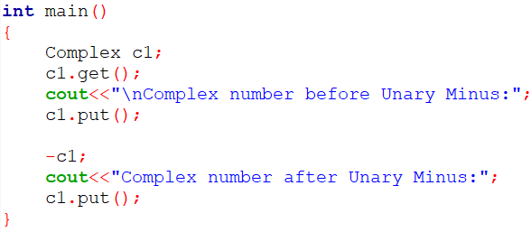

Practical : Overloading Unary Operators Using Friend
Unit 7: Operator Overloading
Prepared By: Nishat Shaikh

Slide 40
Rules for Overloading Operators
There are certain restrictions and limitation in overloading the operators Some of them are listed below:
Only existing operaators can be overloaded New operators cannot be overloaded/created.
The overloaded operator must have at least one operand that is of user defined type
We cannot change the basic meaning of an operator That is to say, We cannot redefine the plus(+) operator to subtract one value from the other
Overloaded operators follow the syntax rules of the original operators They cannot be overridden
There are some operators that cannot be overloaded ( sizeof, . , .*, :: , ?: )
Unit 7: Operator Overloading
Prepared By: Nishat Shaikh

Slide 41
Rules for Overloading Operators
We cannot use friend functions to overload certain operators(=, ( ), [ ], ->) However, member function can be used to overload them
Unary operators, overloaded by means of a member function, take no explicit arguments and return no explicit values, but, those overloaded by means of a friend function, take one reference argument (the object of the relevant class)
Binary operators overloaded through a member function take one explicit argument and those which are overloaded through a friend function take two explicit arguments
When using binary operators overloaded through a member function, the left hand operand must be an object of the relevant class
Binary arithmetic operators such as +, -, * and / must explicitly return a value They must not attempt to change their own arguments
Unit 7: Operator Overloading
Prepared By: Nishat Shaikh

Slide 42
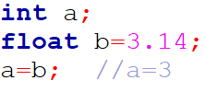
Type Conversions
When different types of constants and variables are used in expression, C automatically perform type conversion based on some fixed rules
In assignment operation, variable at the right hand side is automatically converted to the type of the variable on the left
But this automated type promotion will work well if both data types are of primary data type or both are of same user defined data type
But it will create problem when one data type is user defined data type and another is primary data type or they belong to two different classes.
Unit 7: Operator Overloading
Prepared By: Nishat Shaikh

Slide 43
Type Conversions
So for that we have to use some special function for type conversion as in such cases automatic type conversion can not be performed by the language itself
There are three types of type conversion possible
Conversion from basic type to the class type
Using Constructor
2. Conversion from class type to basic type
Using Casting Operator Function
3. Conversion from one class to another class type
Using Constructor
Using Casting Operator Function
Unit 7: Operator Overloading
Prepared By: Nishat Shaikh

Slide 44
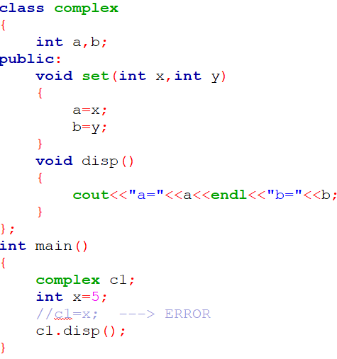
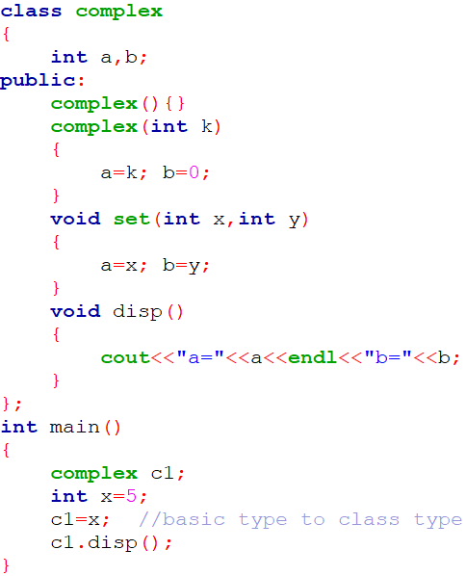
1. Conversion from basic type to the class pe
Unit 7: Operator Overloading
Prepared By: Nishat Shaikh

Slide 45

1. Conversion from basic type to the class type
Create a class Money having integer rupee, paisa as data. Define appropriate functions to enter and display data. Also define function that supports the statement: obj1=115. Here obj1 is object of class and 115 is integer that represents paisa. After execution of the statement obj1 will be 1 rupee 15 paisa.
Use the concept of Type conversion from basic type to class type.
Unit 7: Operator Overloading
Prepared By: Nishat Shaikh

Slide 46
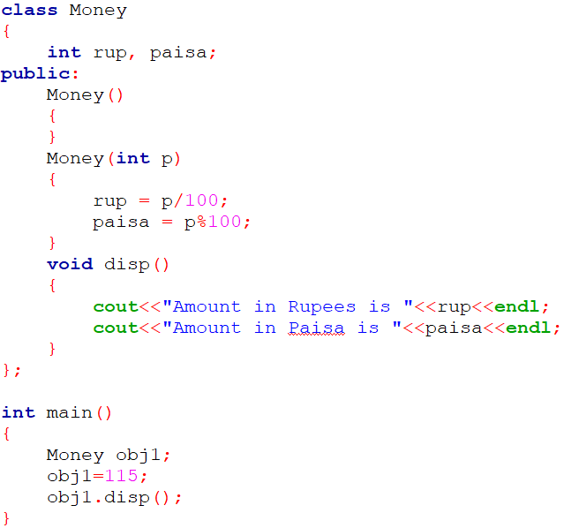

1. Conversion from basic type to the class type
Unit 7: Operator Overloading
Prepared By: Nishat Shaikh

Slide 47
1. Conversion from basic type to the class type
NOTE:
The constructors used for the type conversion take a single argument whose type is to be converted.
Unit 7: Operator Overloading
Prepared By: Nishat Shaikh

Slide 48

2. Conversion from class type to basic type
The general form of an overloaded casting operator function / conversion function:
The casting operator function should satisfy following conditions:
It must be a class member
It must not specify a return type
It must not have any arguments
Unit 7: Operator Overloading
Prepared By: Nishat Shaikh

Slide 49



2. Conversion from class type to basic type
Unit 7: Operator Overloading
Prepared By: Nishat Shaikh

Slide 50
Practical : Type conversion
Create a class Celsius with float. Define appropriate member functions such that it support the statements: C1=30.5F; float temperature; temperature=C2;
Use the concept of Type conversion from basic type to class type and class type to basic type.
Unit 7: Operator Overloading
Prepared By: Nishat Shaikh

Slide 51


Practical : Type conversion
Unit 7: Operator Overloading
Prepared By: Nishat Shaikh

Slide 52


3. Conversion from one class to another class type
i1
p1
a
b
m
n
3
4
Unit 7: Operator Overloading
Prepared By: Nishat Shaikh

Slide 53

3. Conversion from one class to another class type
Unit 7: Operator Overloading
Prepared By: Nishat Shaikh

Slide 54



3. Conversion from one class to another class type
Unit 7: Operator Overloading
Prepared By: Nishat Shaikh

Slide 55
3. Conversion from one class to another class type
Define a class KG having data member float kg and class POUND having data member float lb. Both the classes have default constructor and member functions to get and show data. (1 kg = 2.20462 lb). Define appropriate member functions such that they support the statements in main( ):
KG K; POUND P; P=K;
Use the concepts of Type conversion from class type to class type. Write this Program in two ways. Define appropriate member function in class KG. Define appropriate member function in class POUND.
Pounds=Kilograms * 2.20462262184878
Unit 7: Operator Overloading
Prepared By: Nishat Shaikh

Slide 56


3. Conversion from one class to another class type
Unit 7: Operator Overloading
Prepared By: Nishat Shaikh

Slide 57


3. Conversion from one class to another class type
Unit 7: Operator Overloading
Prepared By: Nishat Shaikh

Slide 58
Practical : Type conversion
Create classes Celsius and Fahrenheit with float. Define appropriate member functions such that they support the statements in main( ): Celsius C1, C2=5.0; Fahrenheit F1, F2; F1=C2; C1=F2;Use the concepts of Type conversion from class type to class type. Write this Program in two ways. Define appropriate member function in class Celsius. Define appropriate member function in class Fahrenheit.
Unit 7: Operator Overloading
Prepared By: Nishat Shaikh

Slide 59


Practical : Type conversion
Unit 7: Operator Overloading
Prepared By: Nishat Shaikh

Slide 60


Practical : Type conversion
Unit 7: Operator Overloading
Prepared By: Nishat Shaikh

Slide 61
Virtual Functions
There is a necessity to use the single pointer to refer to all the objects of the different classes.
So, we create the pointer to the base class that refers to all the derived objects.
But, when base class pointer contains the address of the derived class object, always executes the base class function.
This issue can only be resolved by using the 'virtual' function.
Unit 9: Pointers and Virtual Functions
Prepared By: Nishat Shaikh

Slide 62
Virtual Functions
Virtual function is a member function in the base class that you redefine in a derived class. It is declared using the virtual keyword.
A 'virtual' is a keyword preceding the normal declaration of a function.
It is used to tell the compiler to perform dynamic linkage or late binding on the function.
When the function is made virtual, C++ determines which function is to be invoked at the runtime based on the type of the object pointed by the base class pointer and not by the type of the pointer.
In late binding function call is resolved during runtime. Therefore compiler determines the type of object at runtime, and then binds the function call.
Unit 9: Pointers and Virtual Functions
Prepared By: Nishat Shaikh

Slide 63



Virtual Functions
Unit 9: Pointers and Virtual Functions
Prepared By: Nishat Shaikh

Slide 64
Virtual Functions
NOTE:
Run time polymorphism is achieved only when a virtual function is accessed through a pointer to the base class.
Unit 9: Pointers and Virtual Functions
Prepared By: Nishat Shaikh

Slide 65
Rules of Virtual Function
Virtual functions must be members of some class.
Virtual functions cannot be static members.
They are accessed through object pointers.
They can be a friend of another class.
A virtual function must be defined in the base class, even though it is not used.
The prototypes of a virtual function of the base class and all the derived classes must be identical. If the two functions with the same name but different prototypes, C++ will consider them as the overloaded functions and the virtual function mechanism is ignored
We cannot have a virtual constructor, but we can have a virtual destructor
Unit 9: Pointers and Virtual Functions
Prepared By: Nishat Shaikh

Slide 66
Rules of Virtual Function
While a base pointer can point to any type of the derived object, the reverse is not true. That is to say, we can not use a pointer to a derived class to access an object of base type
When a base pointer points to a derived class, incrementing or decrementing it will not make it to point to the next object of the derived class. It is incremented or decremented only relative to it’s base type. Therefore, we should not use this method to move the pointer to the next object.
Unit 9: Pointers and Virtual Functions
Prepared By: Nishat Shaikh

Slide 67
Practical : Virtual function
Create a class Media that stores the title (a string) and price (float). Class Media has two argument constructor which initializes data members of class Media. Also declare a virtual function display () in Class Media. From the class Media derive two classes: Class book, which contains data member page count (int): and Class tape, which contains data member playing time in minutes (float). Both Class book and Class tape should have a constructor which initializes base class constructor as well as its own data members and display ( ) function which displays book details and tape details respectively. Write a main ( ) to test book and tape classes by creating instances of them, asking the user to fill data and displaying them.
Use the concept of Virtual function and Constructor in Derived Class.
Unit 9: Pointers and Virtual Functions
Prepared By: Nishat Shaikh

Slide 68

Practical : Virtual function
Unit 9: Pointers and Virtual Functions
Prepared By: Nishat Shaikh

Slide 69

Practical : Virtual function
Unit 9: Pointers and Virtual Functions
Prepared By: Nishat Shaikh

Slide 70


Practical : Virtual function
Unit 9: Pointers and Virtual Functions
Prepared By: Nishat Shaikh

Slide 71


Size of Virtual function
Unit 9: Pointers and Virtual Functions
Prepared By: Nishat Shaikh

Slide 72


Size of Virtual function
Unit 9: Pointers and Virtual Functions
Prepared By: Nishat Shaikh

Slide 73
Abstract class & Pure Virtual Functions
It is normal practice to declare a function virtual inside the base class and redefine it in the derived classes.
Such function inside base class is not used for performing any task, it only serves as a placeholder.
For ex, display() function in class Media in previous example. Such functions are called “do-nothing” functions.
A “do-nothing” function may be defined as follows:
Such functions are called pure virtual functions
Unit 9: Pointers and Virtual Functions
Prepared By: Nishat Shaikh

Slide 74
Abstract class & Pure Virtual Functions
A pure virtual function is a function declared in a base class that has no definition relative to the base class.
In such case compiler requires each derived class to either define the function or redeclare it as a pure virtual function.
Class containing pure virtual functions cannot be used to declare any objects of its own and such classes are called abstract base classes
Unit 9: Pointers and Virtual Functions
Prepared By: Nishat Shaikh

Slide 75

Abstract class & Pure Virtual Functions
Unit 9: Pointers and Virtual Functions
Prepared By: Nishat Shaikh

Slide 76


Abstract class & Pure Virtual Functions
NOTE:
A class is abstract if it has at least one pure virtual function.
Unit 9: Pointers and Virtual Functions
Prepared By: Nishat Shaikh

Slide 77

Abstract class & Pure Virtual Functions
2. We can have pointers and references of abstract class type.
Unit 9: Pointers and Virtual Functions
Prepared By: Nishat Shaikh

Slide 78


Abstract class & Pure Virtual Functions
3. If we do not override the pure virtual function in derived class, then derived class also becomes abstract class.
Unit 9: Pointers and Virtual Functions
Prepared By: Nishat Shaikh

Slide 79



Abstract class & Pure Virtual Functions
4. An abstract class can have constructors.
Unit 9: Pointers and Virtual Functions
Prepared By: Nishat Shaikh

Slide 80
Practical :Abstract class & Pure Virtual Functions
Create an Abstract class vehicle having average as data and pure virtual function getdata() and putdata(). Derive class car and truck from class vehicle having data members: fuel type (petrol, diesel, CNG) and no of wheels respectively. Write a main ( ) that enters the data of two cars and a truck and display the details of them.
Use the concept of Abstract Base class and Pure Virtual functions.
Unit 9: Pointers and Virtual Functions
Prepared By: Nishat Shaikh

Slide 81

Practical :Abstract class & Pure Virtual Functions
Unit 9: Pointers and Virtual Functions
Prepared By: Nishat Shaikh

Slide 82

Practical :Abstract class & Pure Virtual Functions
Unit 9: Pointers and Virtual Functions
Prepared By: Nishat Shaikh

Slide 83


Practical :Abstract class & Pure Virtual Functions
Unit 9: Pointers and Virtual Functions
Prepared By: Nishat Shaikh

Slide 84
Dynamic Memory Management Operators
We use dynamic allocation techniques when it is not known in advance how much of memory space is needed
C uses malloc() and calloc() functions to allocate memory dynamically at run time. Similarly, it uses the function free() to free dynamically allocated memory.
Although C++ supports these functions, it also defines two unary operators new and delete that perform the task of allocating and freeing the memory in a better and easier way.
Since these operators manipulate memory on the free store, they are also known as free store operators .
Unit 3: Tokens and Expressions & Control Structure
Prepared By: Nishat Shaikh

Slide 85
Dynamic Memory Management Operators
An object can be created by using new, and destroyed by using delete, as and when required.
A data object created inside a block with new , will remain in existence until it is explicitly destroyed by using delete.
Thus, the Lifetime of an object is directly under our control and is unrelated to the block structure of the program.
Unit 3: Tokens and Expressions & Control Structure
Prepared By: Nishat Shaikh

Slide 86

new operator
The new operator can be used to create objects of any type:
Alternatively, we can combine the declaration of pointers and their assignments as follows:
Following statement assign 25 to the newly created int object:
We can also initialize the memory using the new operator
Unit 3: Tokens and Expressions & Control Structure
Prepared By: Nishat Shaikh

Slide 87


new operator
The general form for a one-dimensional array is:
When creating multi-dimensional arrays with new, all the array sizes must be supplied.
Unit 3: Tokens and Expressions & Control Structure
Prepared By: Nishat Shaikh

Slide 88

new operator
if sufficient memory is not available for allocation, new returns a null pointer
Unit 3: Tokens and Expressions & Control Structure
Prepared By: Nishat Shaikh

Slide 89

delete operator
When a data object is no longer needed. it is destroyed to release the memory space for reuse:
lf we want to free a dynamically allocated array, we must use the following form of delete:
Recent versions of C++ do not require the size to be specified:
Unit 3: Tokens and Expressions & Control Structure
Prepared By: Nishat Shaikh

Slide 90


Practical : Dynamic Memory Management Operators
Create an array of size given by user using “new” operator (free store operator). Enter the data to store in array and display the data after adding 2 to each element in the array. Delete the array by using “delete” memory management operator.
Unit 3: Tokens and Expressions & Control Structure
Prepared By: Nishat Shaikh

